Slide 1

© Technical Spark

Slide 2
colloquium presentation
- SARVESH SINGH
1403213090
© Technical Spark
1

Slide 3
Hardware
Software
Communication
Software
Hardware
© Technical Spark

Slide 4

Demostration
© Technical Spark

Slide 5


Slide 6
Code
© Technical Spark

Slide 7
Hardware
© Technical Spark

Slide 8
Arduino
Accelerometer
ADXL3xx
Bluetooth
HC0x
Open-Source Prototyping Platform
© Technical Spark

Slide 9
Gesture Control
Wireless Communication
Introduction To Accelerometer
Bluetooth
What’s Inside Accelerometer??
Master
Various Classifications
Slave
© Technical Spark

Slide 10
Gesture Control
Wireless Communication
Introduction To Accelerometer
Bluetooth
Master
What’s Inside Accelerometer??
Slave
Various Classifications
© Technical Spark

Slide 11
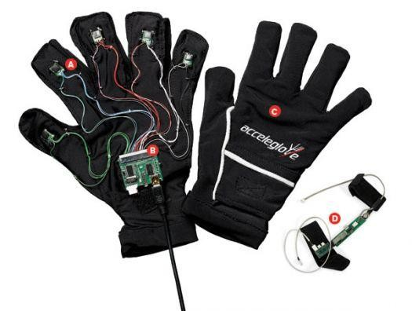
Introduction To Accelerometer
– H o w it works???
It All Begins Here…
© Technical Spark

Slide 12

So, What is an accelerometer???
→ Simply stated … It is a device that measures
acceleration
forces.
STATIC
(due to gravity)
DYNAMIC
(w.r.t Device)
→ Measures the tilt of
the device
(w.r.t. gravity)
→ Analyze the way
device is moving
→Vibrations & Shocks
© Technical Spark

Slide 13
So, What is an accelerometer???
→ To put simply… It is a device that measures
acceleration
forces.
STATIC
(due to gravity)
DYNAMIC
(w.r.t Device)
→ Measures the tilt of
the device
(w.r.t. gravity)
→ Analyze the way
device is moving
→Vibrations & Shocks
© Technical Spark

Slide 14
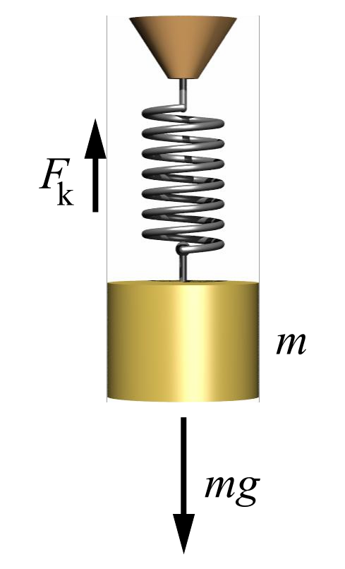
Understanding Accelerometer
Remember Hooke’s law:
f_{k} = kx = mg
g=(kx)/m
Now Somehow mechanical displacement →
electrical signal
piezoelectric, piezoresistive or capacitive components
© Technical Spark

Slide 15
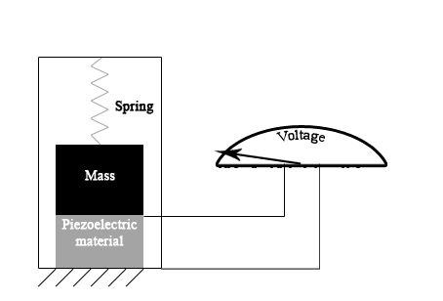
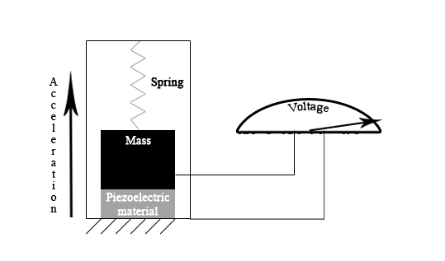
Understanding Accelerometer
These tiny crystal structures output electrical charge
when placed under mechanical stress ( e.g. acceleration).
© Technical Spark

Slide 16
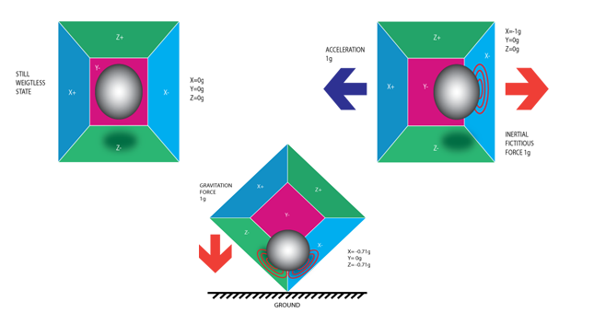
So, How does it work???
© Technical Spark

Slide 17
So, How does it work???
An accelerometer works on the principle of piezo electric effect. Here, imagine a cuboidal box, having a small ball inside it, like in the picture above. The walls of this box are made with piezo electric crystals. Whenever you tilt the box, the ball is forced to move in the direction of the inclination, due to gravity. The wall with which the ball collides, creates tiny piezo electric currents. There are totally, three pairs of opposite walls in a cuboid. Each pair corresponds to an axis in 3D space: X, Y and Z axes. Depending on the current produced from the piezo electric walls, we can determine the direction of inclination and its magnitude.
© Technical Spark

Slide 18
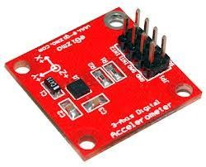
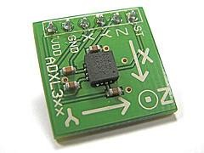
So, What is an accelerometer???
electromechanical
→
Simply stated… It is a ^ device that measures
acceleration force
Another Classification
Digital Accelerometer Vs Analog Accelerometer
© Technical Spark

Slide 19
So, What is an accelerometer??
electromechanical
→
Simply stated… It is a ^ device that measures
acceleration force
Another Classification
Digital Accelerometer Vs Analog Accelerometer
Digital accelerometers usually use pulse width modulation (PWM) for their output. This means there will be a square wave of a certain frequency, and the amount of time the voltage is high will be proportional to the amount of acceleration.
© Technical Spark

Slide 20
So, What is an accelerometer??
electromechanical
→
Simply stated… It is a ^ device that measures
acceleration force
Another Classification
Digital Accelerometer Vs Analog Accelerometer
Analog style accelerometers output a continuous voltage that is proportional to acceleration. E.g. 2.5V for 0g, 2.6V for 0.5g, 2.7V for 1g and so on.
© Technical Spark

Slide 21
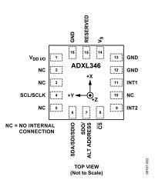
Digital Accelerometer
+ used when pure digital inputs are available in microcontroller
+ requires the knowledge of SPI(Serial Peripheral Interface)
or I²C(Inter Integrated Circuit Communication)
Analog Accelerometer
+ used when ADC inputs are available in microcontroller.
+ requires little knowledge of Programming acceleration=read_adc();
© Technical Spark

Slide 22
?Digital Accelerometer
+ used when pure digital inputs are available in microcontroller.
+ requires the knowledge of SPI(Serial Peripheral Interface) or
I²C(Inter Integrated Circuit Communication)
Analog Accelerometer
+ used when ADC inputs are available in microcontroller.
+ requires little knowledge of Programming acceleration=read_adc();
-- Values flicker a bit
© Technical Spark

Slide 23
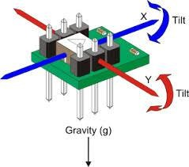
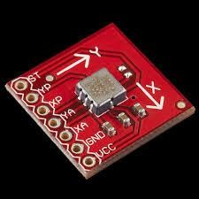
Two Axis Accelerometer Vs Three Axis Accelerometer
→Responds to change in value in only 2 axes .
→Corresponds to 4 different motion in space. (Still sufficient)
© Technical Spark

Slide 24
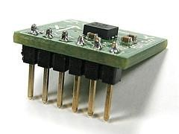
Two Axis Accelerometer Vs Three Axis Accelerometer
→Responds to change in value in all 3 axes .
→Corresponds to all different motion in space.
→Cost is almost the same as Two Axis Accelerometer.
© Technical Spark

Slide 25

Accelerometers : u have seen them everywhere
→ Used in mobile phones
here accelerometer is used to present
landscape or portrait views of the device's screen
→ In Cricket
What about Cricket ???
→ In Laptops
Many laptops feature an accelerometer which is used to detect drops. If a drop is detected, the heads of the hard disk are parked to avoid data loss and possible head or disk damage by the ensuing shock.
© Technical Spark

Slide 26
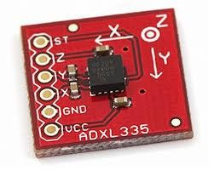
CONCLUSIONS:
How Should our Accelerometer be… ???
→It should measure both Static + Dynamic acceleration
→It should be an analog one.
→It should have 3 Axes.
→Sensitivity should be high
ADXL335
© Technical Spark

Slide 27
ADXL335
Is Your Accelerometer Working Properly??
→ Set this pin to 3V, an electrostatic force is exerted on the accelerometer beam.
→ Check the voltages Vx , Vy , Vz on X , Y and Z pins respectively.
→ If Vx= --(0.325)V and Vy= +(0.325)V and Vz=+(.550)V . Accelerometer is working properly ☺
This ST pin can be left open-circuit or connected to common (COM) in normal use
© Technical Spark

Slide 28
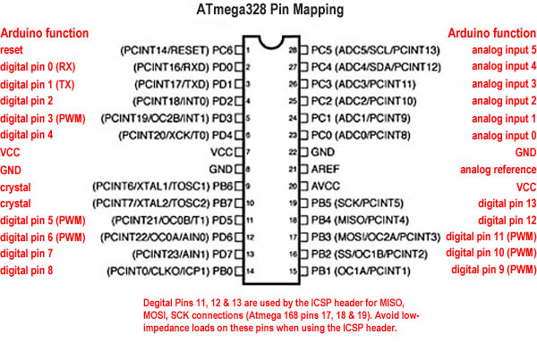
WHAT’S NEXT??
Now That We Have Got Our Required Accelerometer
Now we need to convert the available analog signal from accelerometer to digital signal.
→Use ADC Pins of ATMEGA 328(ARDUINO UNO)
→ Connect Gnd & Vcc
→ Use required Capacitors at X,Y & Z.
© Technical Spark

Slide 29
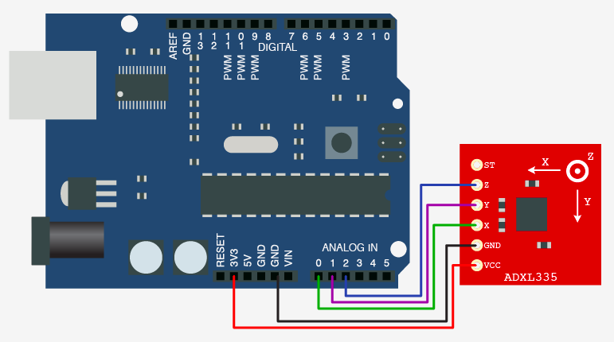
Pin Configuration
© Technical Spark

Slide 30
Alternate
Sensoduino
MPU6050

Slide 31
Communication
© Technical Spark

Slide 32
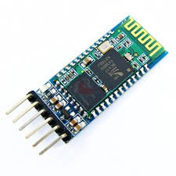
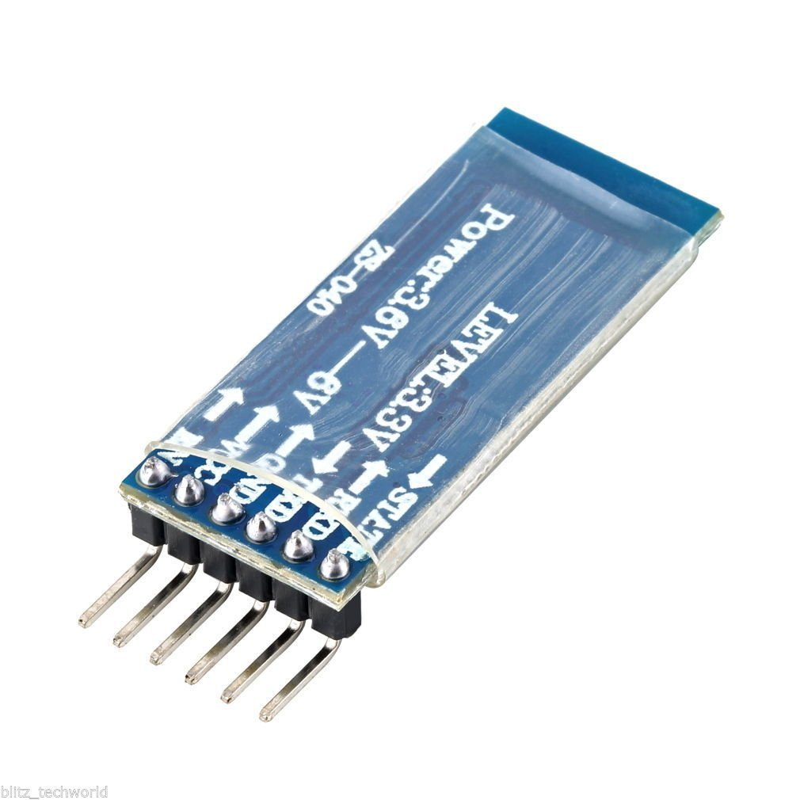
Wireless Communication &
Bluetooth Module
© Technical Spark

Slide 33
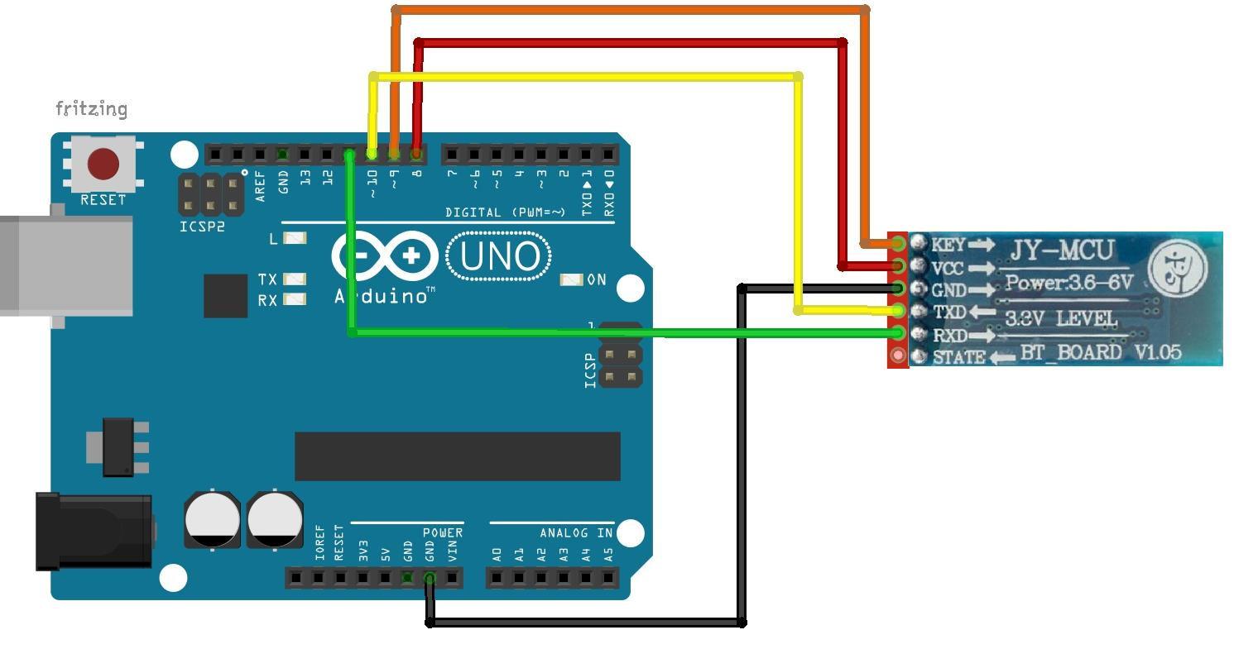
Pin Configuration
© Technical Spark

Slide 34
Master
Slave
© Technical Spark

Slide 35

Video
© Technical Spark

Slide 36

© Technical Spark
© Technical Spark

